Slide 1



Slide 2

Smart Mirror
Supervised by:
Mr Jamal Ahmad
Group Members:
Laraib Un Nisa(SP18-BCS-008)
Hala Ali (SP18-BCS-023)
Department of Computer Science
COMSATS University Islamabad, Attock Campus

Slide 3
Outline
Introduction
Working flow
Comparison table
Problem statement
Objectives
Methodology
Modern tools
Benefits
Future Work
Interface
Conclusion

Slide 4

Introduction
Smart mirrors are straight from science fiction. They’re part of an optimistic vision of the future that imagines a world where screens and data are everywhere, ready to feed you whatever information you need at a moment’s notice.
It has widgets for displaying the current whether conditions, Time, Events, Latest news.
The mirror works with the assistance of a raspberry pi. There are a few shows or notice sheets present that are hard to work physically.
It tends to be hard to adequately get ready for the afternoon while remaining learned about current issues and still keep up a convenient timetable.

Slide 5
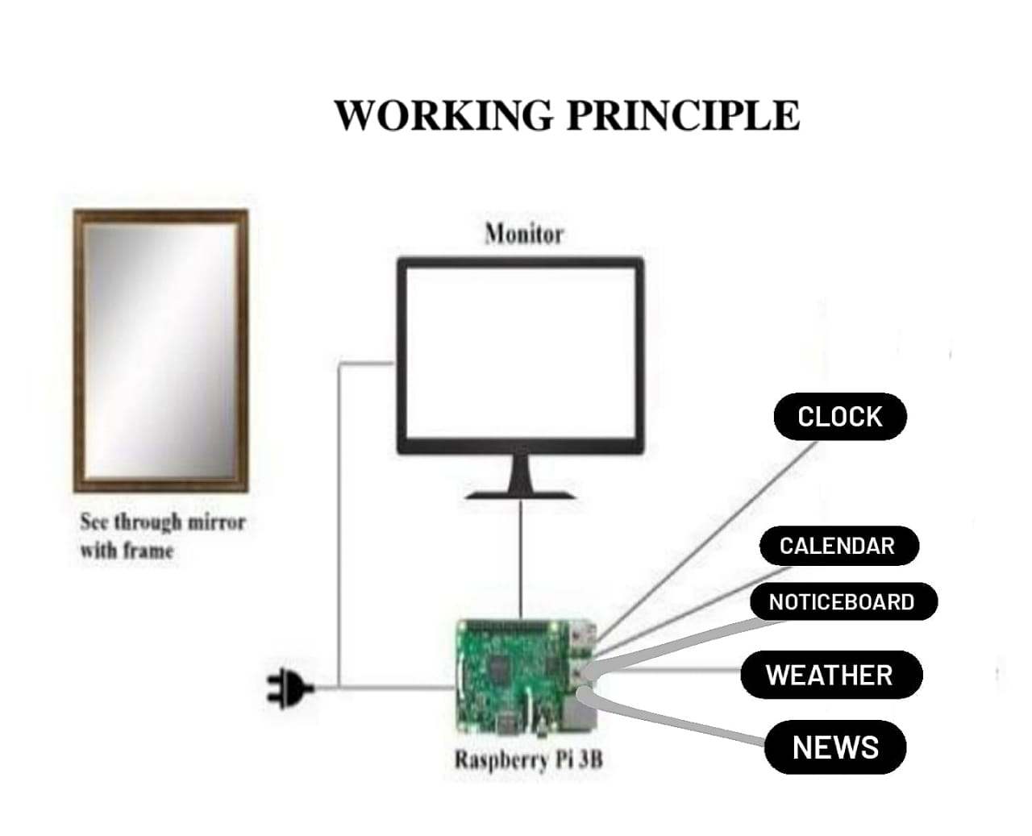
Working flow

Slide 6
Applications And Comparison Table
Parameters | Paper 1: Fatma Ok | Paper 2: Murat Can | Paper 3: Hakan Ucgun | Paper 4: Ugur Yugec
Technology | Raspberry Pi 3 | Raspberry Pi 2 | Pineapple Pi | Raspberry Pi 3
Language | Python | Java | Python | Go Lang
Display applications | Weather, news, date, time, temperature | Weather, news, in-built applications | Weather, news, things to do reminder, temperature | Weather, news, in-built alarm, date, time
Personal assistant | ✔ | ✔ | ✖ | ✖

Slide 7
Problem statement
The major problem is with existing mirror is it shows only any object kept in front of that or face of human.
People wastes their lot of time standing in front of time then after of they read news so all this is time consuming.
So we are developing a project which overcomes to time wastage

Slide 8
Objectives
The objective of this project is to make a mirror
which does the smart things like it shows weather, date and time, News etc.
All these smart features are to be done using raspberry pi.
Due to use of smart mirror time can be saved.

Slide 9
METHODOLOGY
A wooden frame will be prepared with LED attached behind the glass with all the sensors and the raspberry pi.
The power supply is attached to the raspberry pi which will power the LED monitor and the sensors.
Once the mirror is activated, it will connect to the docker which contains all api and software needed to run the mirror.
This will require internet access which will be provided by the wi-fi module (LAN can be also used) on the raspberry pi.

Slide 10
MODERN TOOLS
Development Tool:
A Raspberry Pi 3.
A screen / monitor.
A two-way glass reflect.
A mouse.
A Frame.
A keyboard.
A Micro SD card.
USB-C.
HDMI Micro

Slide 11
BENEFITS
The big benefit of a smart mirror is the ability to display useful information without needing to open apps or do anything.
You simply look at your smart mirror and the information is there.
A smart mirror can easily be customized to include whatever information you want
A great benefit of building your own smart mirror is the modules and software other people have already built.

Slide 12
Future Work
Everything needs to be updated or upgraded on a timely basis to cope up with the current technology.
The most basic feature can be smart mirror-based home automation which will provide a natural means of interaction by which we can control the household appliances like switch on/off light and fans through basic voice commands
we are using this mirror in college environment, basic functionalities like barcode scanner or finger print sensor can be integrated to fulfill basic tasks such as college attendance or program registrations etc.

Slide 13
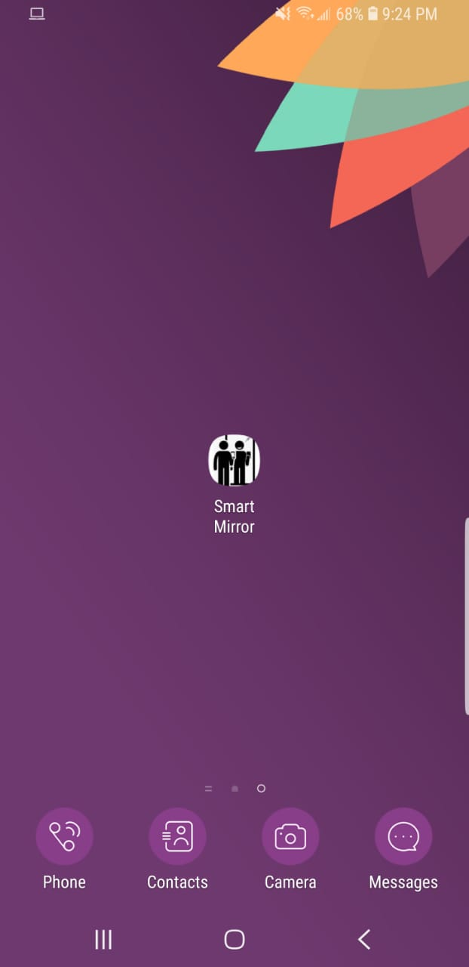
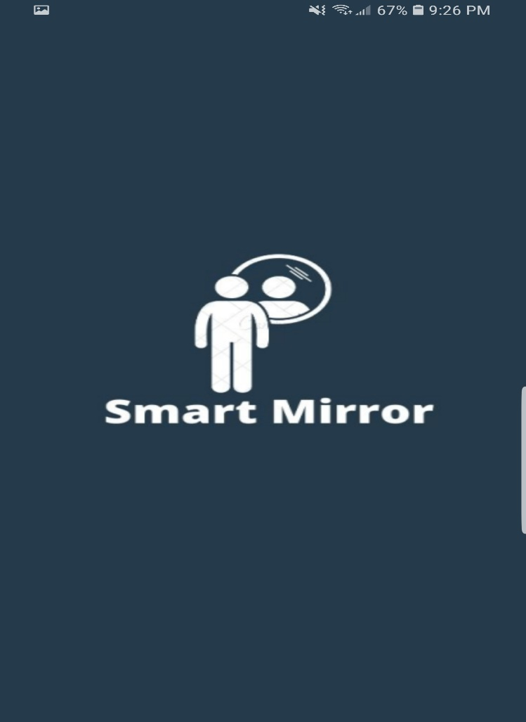
Interface
Icon & Splash Screen

Slide 14
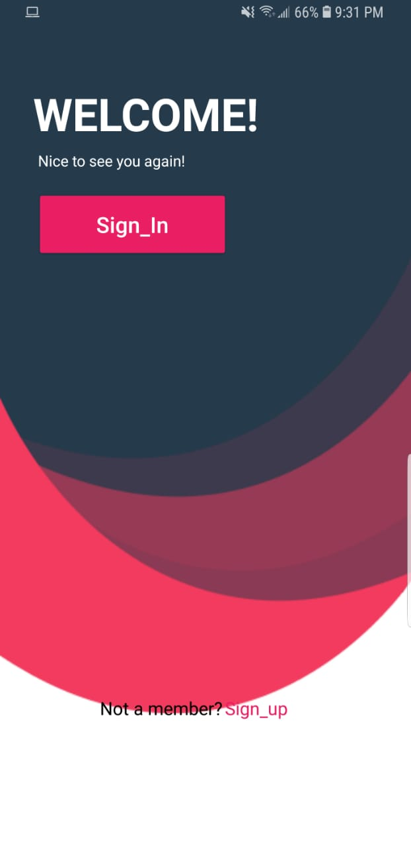
Welcome Page
Sign In & Sign Up

Slide 15
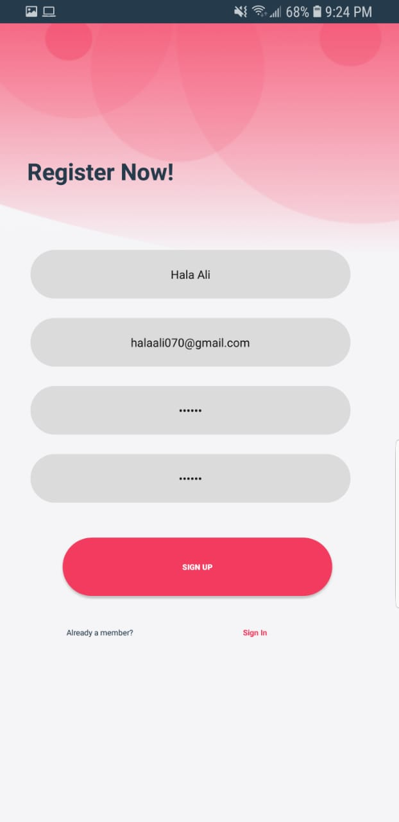
Register Now
Sign Up Page

Slide 16
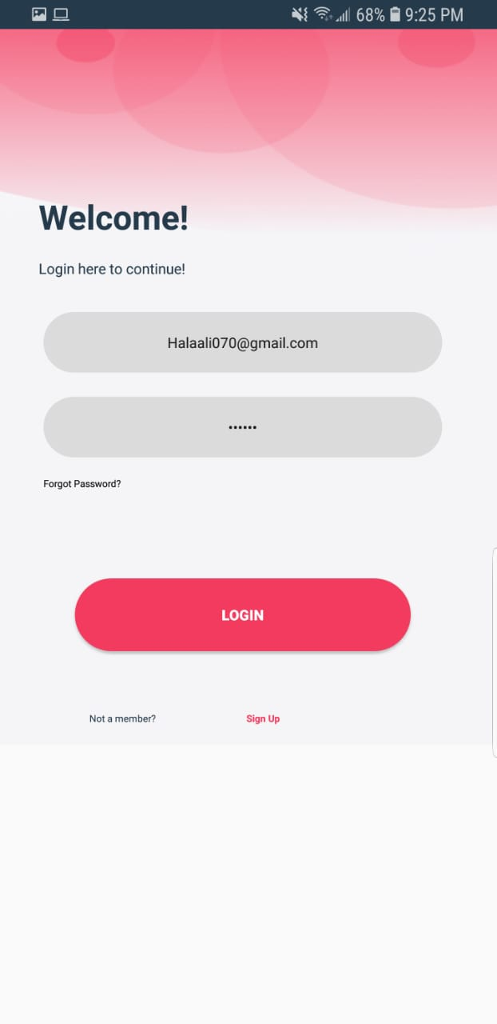
Login Screen
Sign In

Slide 17
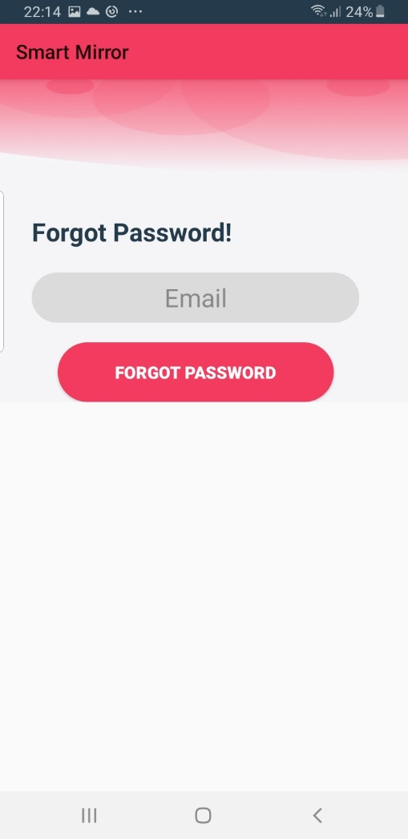
Forgot Password

Slide 18
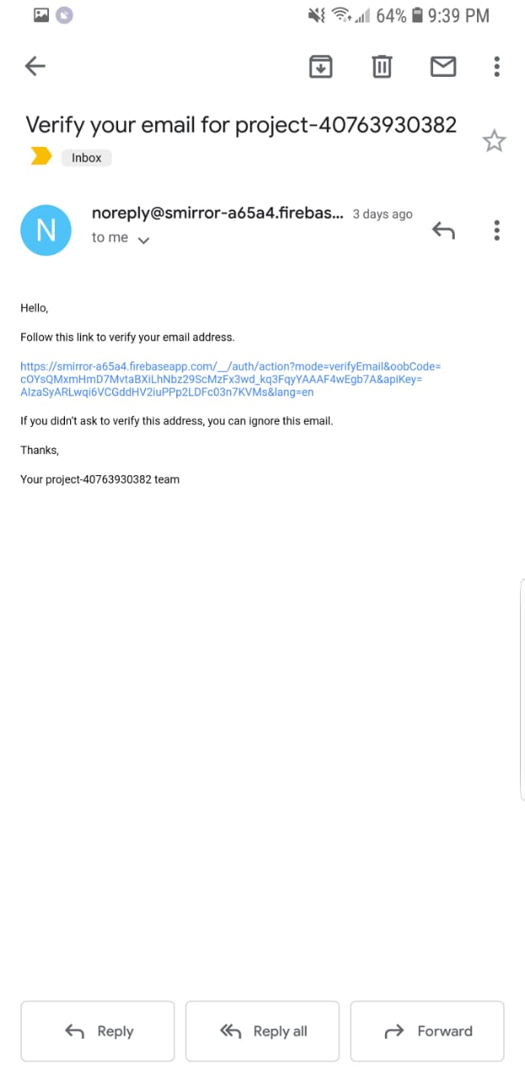
Verification of Email

Slide 19
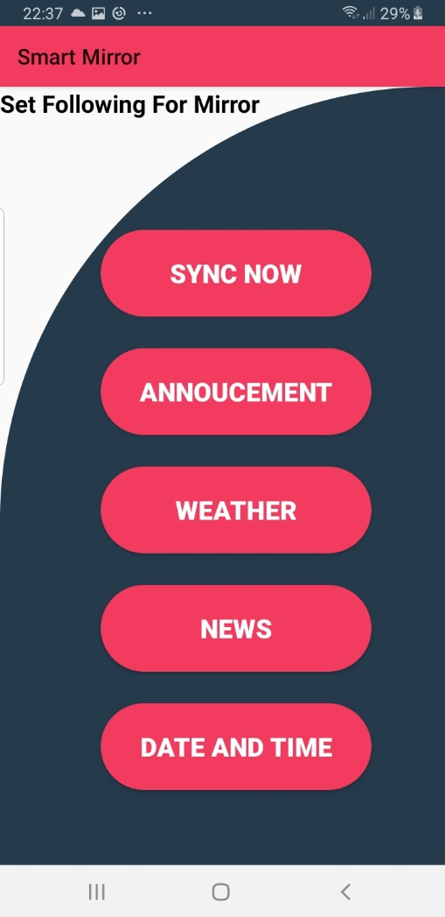
Dashboard

Slide 20
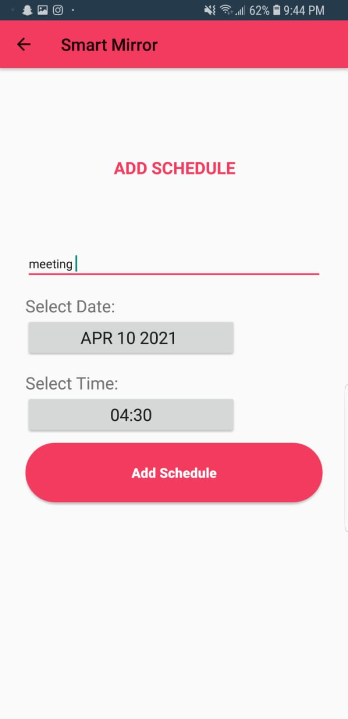
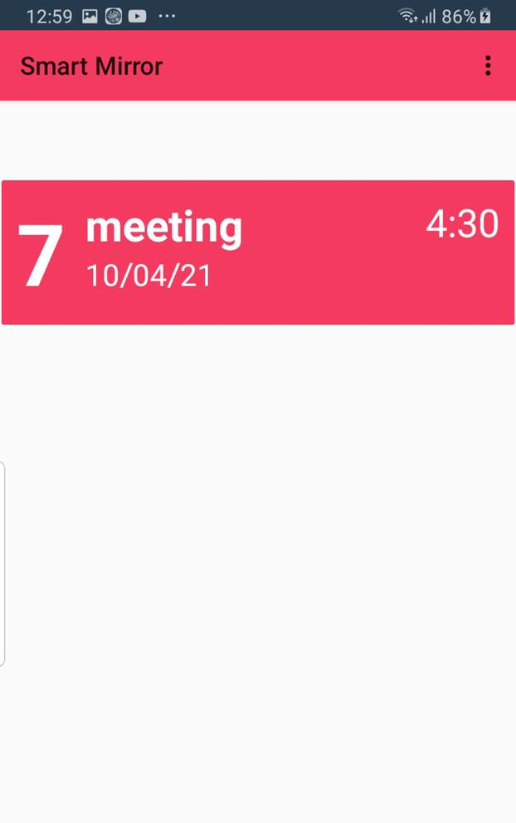
Add Schedule

Slide 21
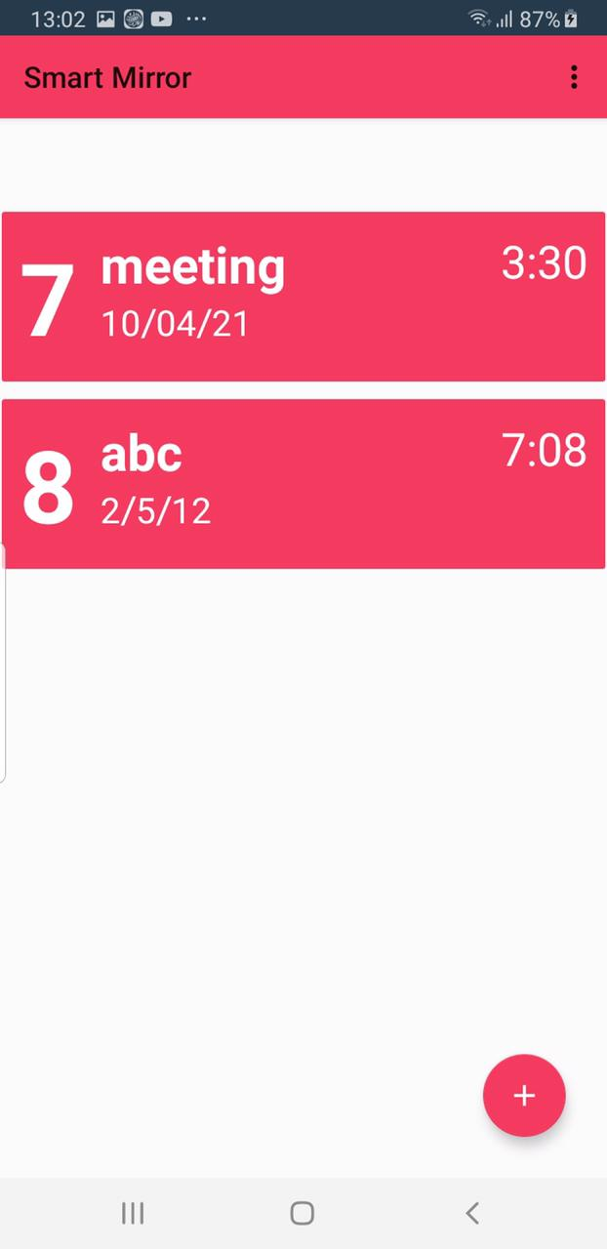
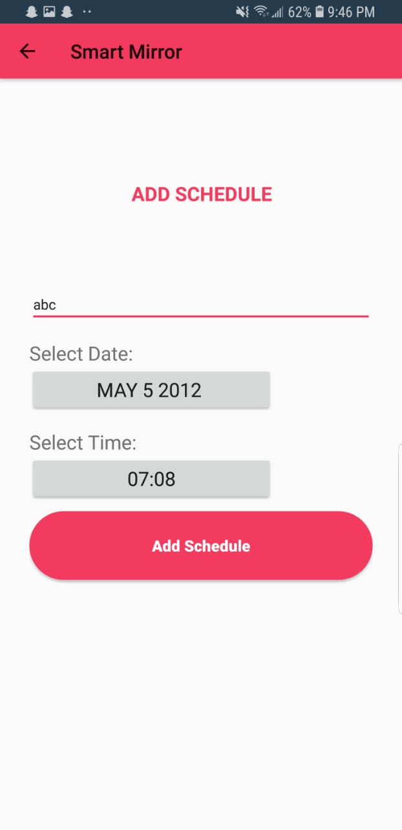
Add Schedule

Slide 22
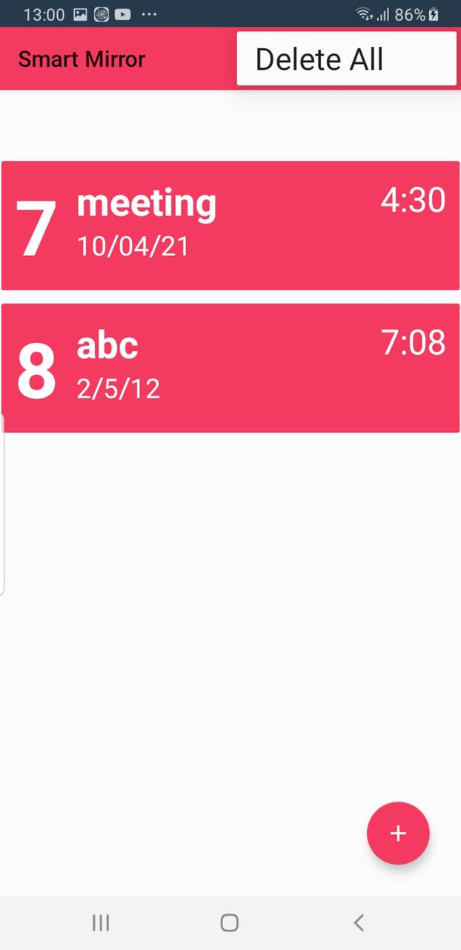
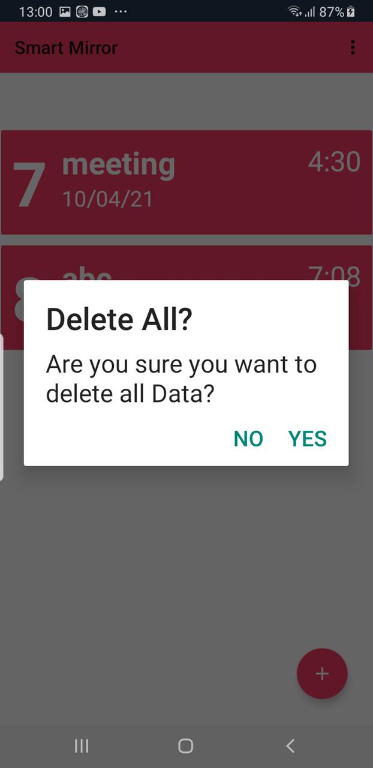
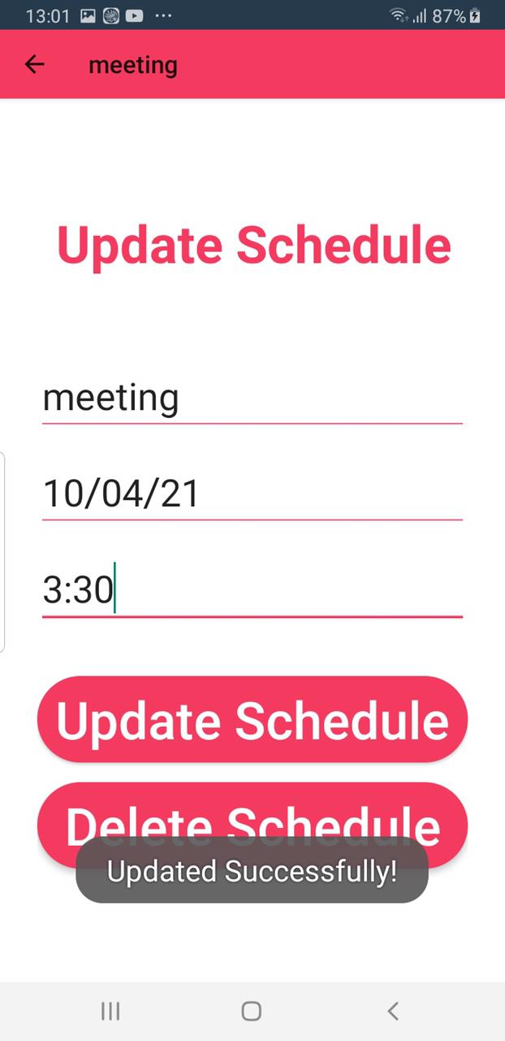
Delete & Update Schedule

Slide 23
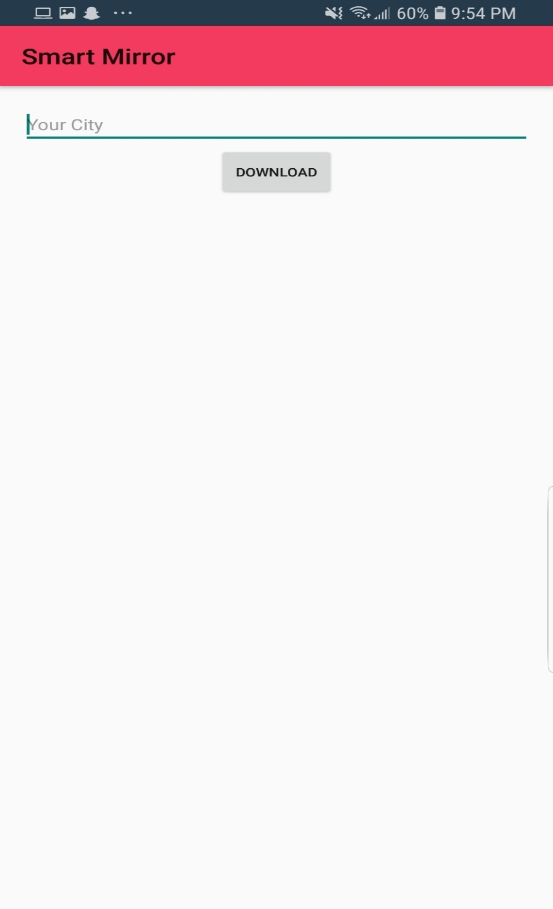
Weather

Slide 24
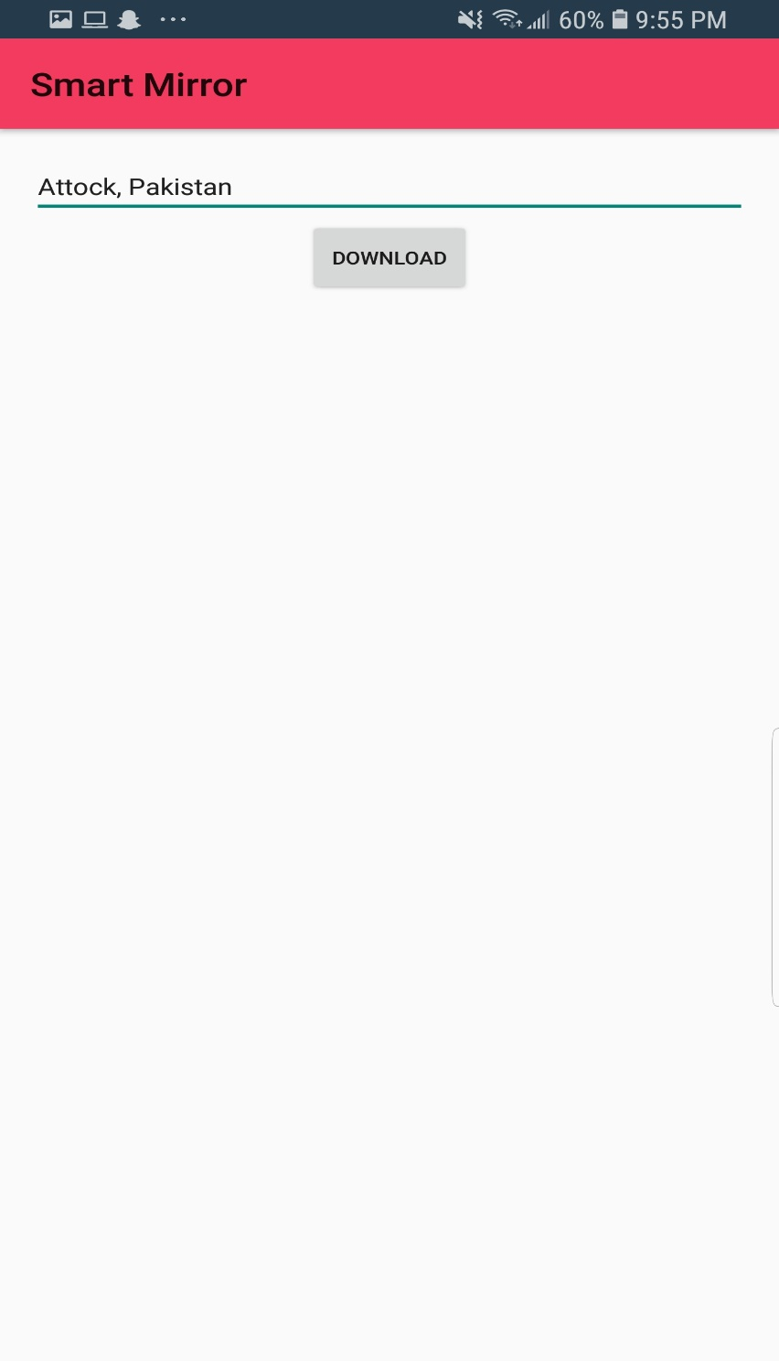
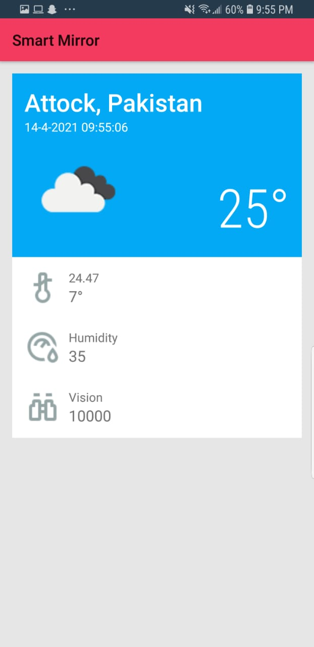
Weather
Add City

Slide 25
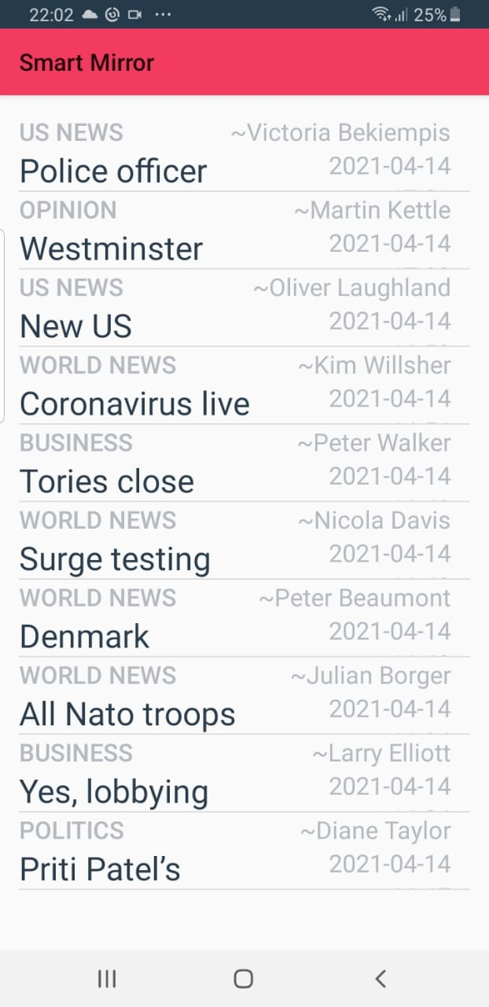
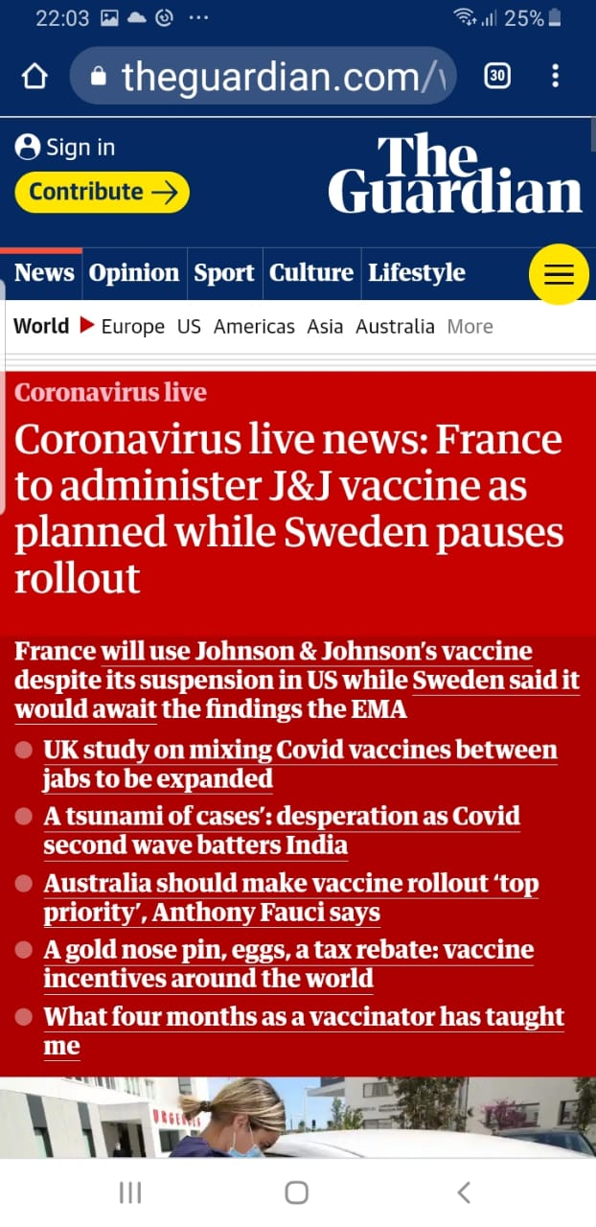
News

Slide 26
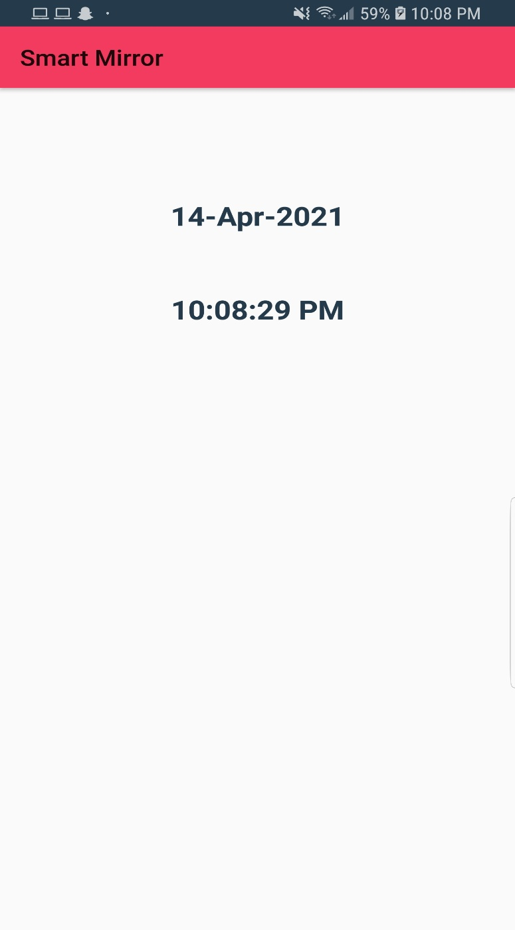
Date & Time

Slide 27
Conclusion
We have designed an android app using android studio and java language
For data storage we have used Firebase Database
Sign In & Signup forms are designed to get into the app
Email Verification is done
If he/she forget his/her password we created another activity from which the user can reset the password.
We can add, delete & update the schedule activity using this app
Going to widget feature, we can get to know about the weather-forecast of our current location.
Through News features, we can get to know about current news
Date & Time is also mentioned in the last feature

